Slide 1

WELCOME TO MY BOOK REVIEW PRESENTATION
PRESENTED BY SAGOR DAS
ID: 232-15-294
DEPARTMENT OF CSE
DAFFODIL INTERNATIONAL UNIVERSITY
PRESENTED TO MR. SHAMIM HOSSAIN
SENIOR LECTURER
COMPUTER SCIENCE AND ENGINEERING
DAFFODIL INTERNATIONAL UNIVERSITY

Slide 2

THE ALCHEMIST
Novel by Paulo Coelho
Author: Paulo Coelho
Original title: O Alquimista
Language: Brazilian Portuguese
Genre: Quest, adventure, fantasy
Publisher: HarperTorch
Publication Year: 1988
Published in English: 1993
THE ALCHEMIST

Slide 3
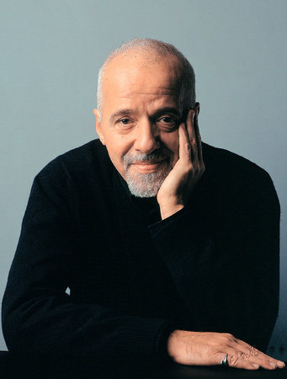
Author’s Introduction
Name: Paulo Coelho
Date of Birth: 24 August 1947
Profession: Novelist
Nationality: Brazilian
Language: Portuguese
Famous works: The Alchemist, Veronika Decides to Die, Brida, The Pilgrimage, Eleven Minutes etc.
PAULO COELHO
THE ALCHEMIST

Slide 4
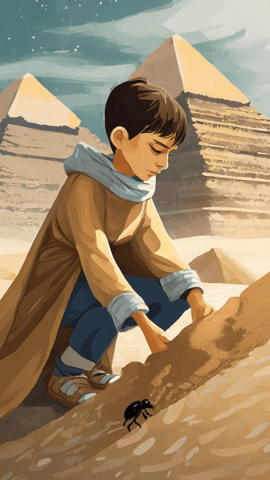
PLOT OVERVIEW
Follows Santiago, a young shepherd in Spain
Dreams of finding a treasure in Egypt
Encounters various mentors and challenges along the journey
THE ALCHEMIST

Slide 5
MAJOR CHARACTERS

Slide 6

SANTIAGO
An adventures young Andalusian shepherd determined to fulfill his Personal Legend, which is to find a treasure at the foot of the Egyptian pyramids. He is the book's protagonist (the lead lead character of novel).

Slide 7
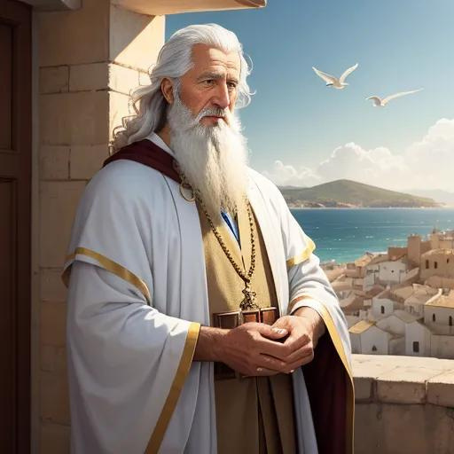
The Alchemist
A 200-year-old, extremely powerful alchemist residing in the Al-Fayoum Oasis.
He dresses in black, rides a white horse, and carries a scimitar, the Philosopher’s Stone, and the Elixir of Life.
He often speaks cryptically, but he understands the Soul of the World and the importance of Personal Legends.

Slide 8

Fatima
Fatima is a beautiful desert woman whom Santiago meets during his travels in the Sahara.
Fatima is patient, understanding, and supportive of Santiago's quest, despite the risks involved.
Symbol of Santiago’s love and dreams

Slide 9
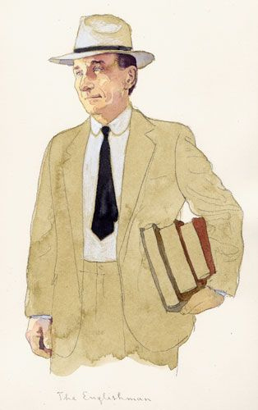
The Englishman
The Englishman is a fellow traveler whom Santiago meets on his journey to the pyramids.
He is a scholarly and intellectual character who is fascinated by the study of alchemy.

Slide 10
Themes
Personal Legend: Pursuing one's dreams and destiny
Omens: Signs and guidance from the universe
The Soul of the World: Unity and interconnectedness of all things

Slide 11
Symbols and Motifs
The Desert: Symbolizes challenges and obstacles
The Pyramids: Represents Santiago's ultimate goal
The Language of the World: Communication beyond words

Slide 12
Critical Reception
Translated into numerous languages worldwide
Bestseller with over 65 million copies sold
Praised for its inspirational and philosophical themes

Slide 13
Inspirational Quotes
"And, when you want something, all the universe conspires in helping you to achieve it."
"There is only one thing that makes a dream impossible to achieve: the fear of failure."
"There is only one way to learn. It's through action."

Slide 14
Conclusion
"The Alchemist" is a timeless tale of self-discovery and pursuing one's dreams, resonating with readers across cultures and generations.
Encourages readers to listen to their hearts and follow their dreams, no matter the obstacles.

Slide 15
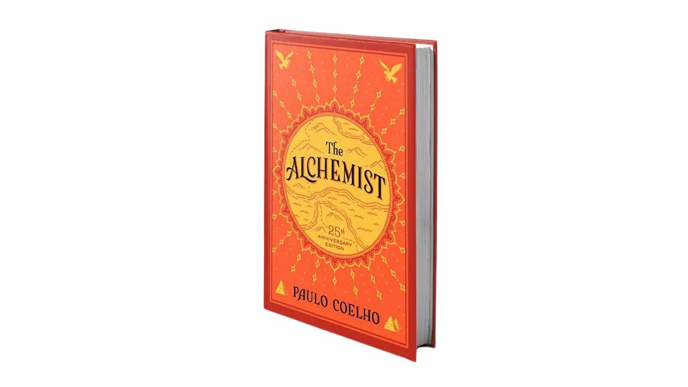
THANK YOU

